Slide 1

IST 718
Group Project Proposal
Checkpoint 2 SOAR Analysis
12 March 2023
Life Expectancy
Nick McFadden
Sahil Nanavaty
Phuong (Adrianne) Van
Cole Wood

Slide 2
Specification – What Problems are We Trying to Solve?
What are the top three factors of life expectancy? Any other major factors?
Does life expectancy have a positive or negative relationship with the various factors (eating habits, population, exercise, health, etc)
Should a country having a lower life expectancy value(<65) increase its healthcare expenditure in order to improve its average lifespan?

Slide 3
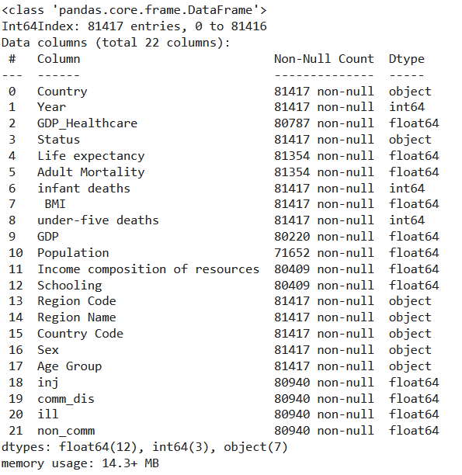




Observation - About the Data
Global life expectancy data set from 2000-2015 (22 columns and 2,938 rows)
Data comes from the World Health Organization (WHO)
Contains over 193 countries
Includes 20 other data sets: communicable and non-communicable diseases
Kaggle: https://www.kaggle.com/datasets/kumarajarshi/life-expectancy-who
WHO: https://platform.who.int/mortality/themes/theme-details/topics/topic-details/MDB/nutritional-deficiencies
World Bank: https://data.worldbank.org/indicator/SH.XPD.CHEX.GD.ZS

Slide 4
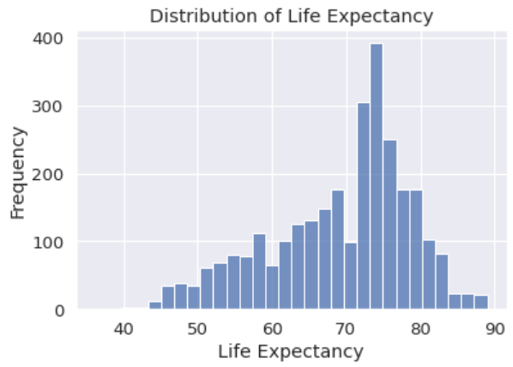
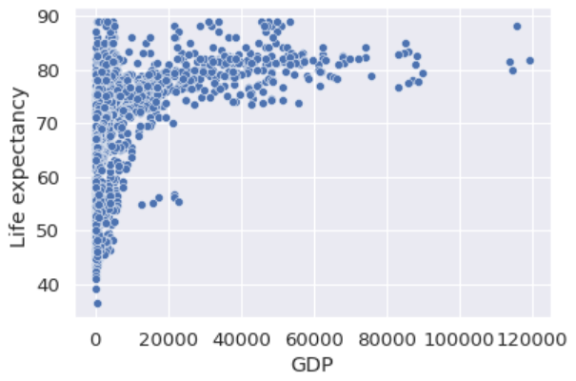
Observation - EDA

Slide 5
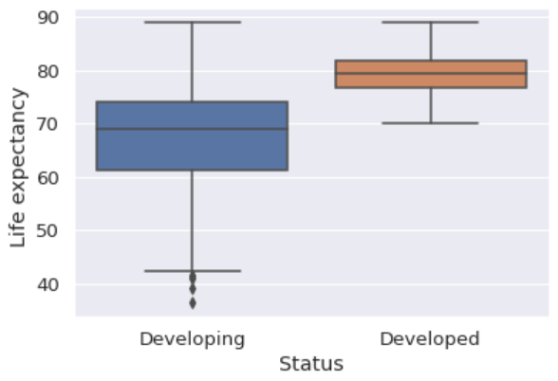
Observation - EDA
Bar plots illustrating difference between life expectancy distribution between developing and developed countries

Slide 6
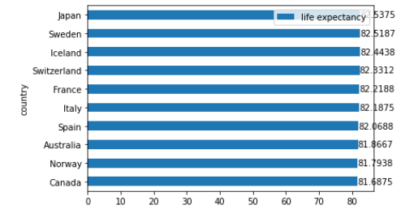
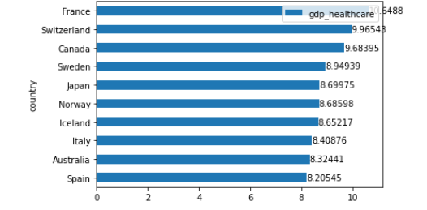
Observation
Generally observing a higher GDP health care % for countries with a higher average life expectancy
Top 10 Countries with Highest Life Expectancy
GDP Healthcare for Top 10 Countries
with Highest Life Expectancy

Slide 7
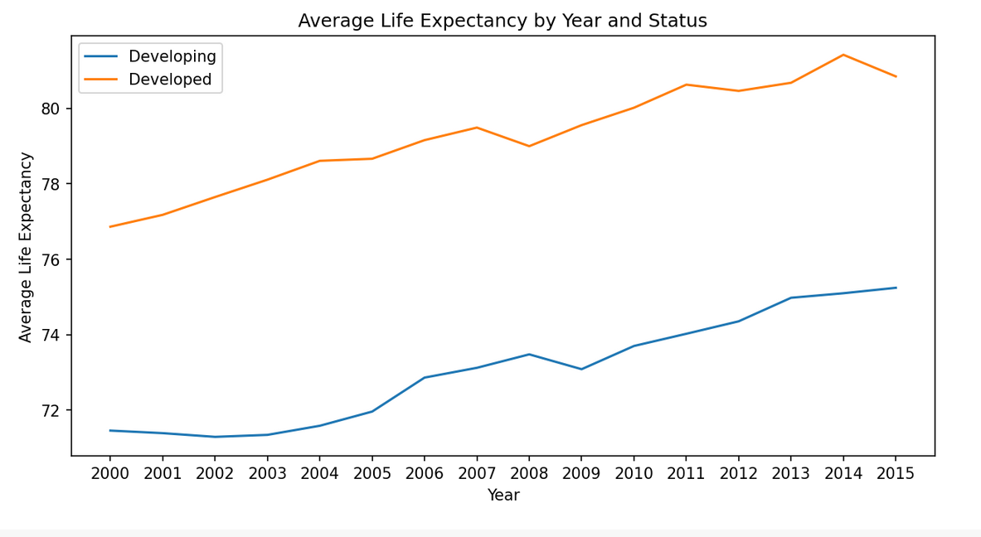
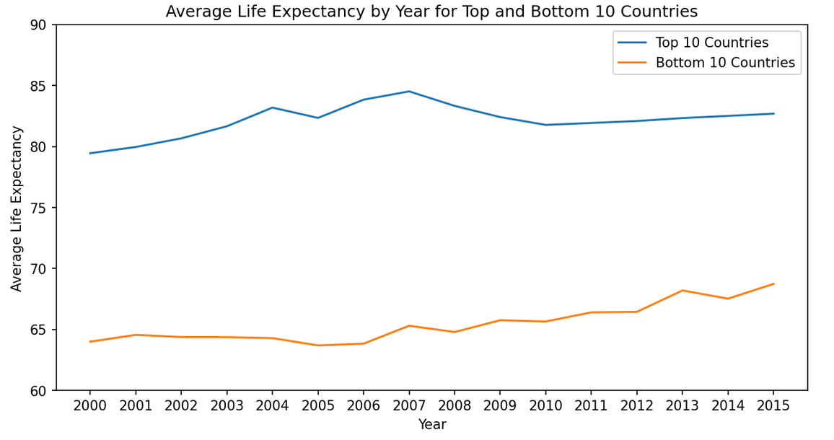
Observation
Significant gap between developed and developing countries; however, life expectancy has been improving for both developed and developing countries over time as observed from 2000 to 2015.

Slide 8
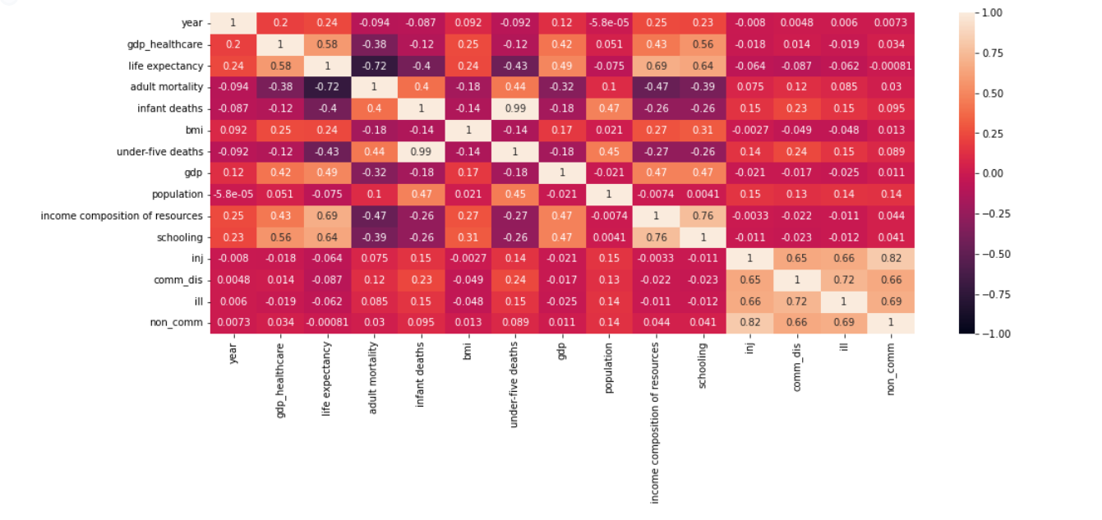
Observation
The following factors have the highest correlation to life expectancy: gdp_healthcare, adult mortality, income composition of resources and schooling

Slide 9
Analysis
Determining and developing necessary models
Currently testing linear regression, KNN, and Random Forest models
Using linear regression techniques to determine the most statistically significant variables for life expectancy
Final models used will be determined using cross validation techniques and based on accuracy for each

Slide 10
Recommendation
Determine any outliers in data set that are potentially skewing model prediction results
Utilize regression model to validate if highly correlated factors are statistically significant
Continue to develop and determine models to predict life expectancy based on factors
Employ cross validation techniques to assess reliability of various models
Ensure business questions are addressed and appropriate recommendations are given

Slide 11

THANK YOU!

